Slide 1


A Swift View of the Universe
Professor Lynn Cominsky
Department of Physics and Astronomy
Sonoma State University

Slide 2
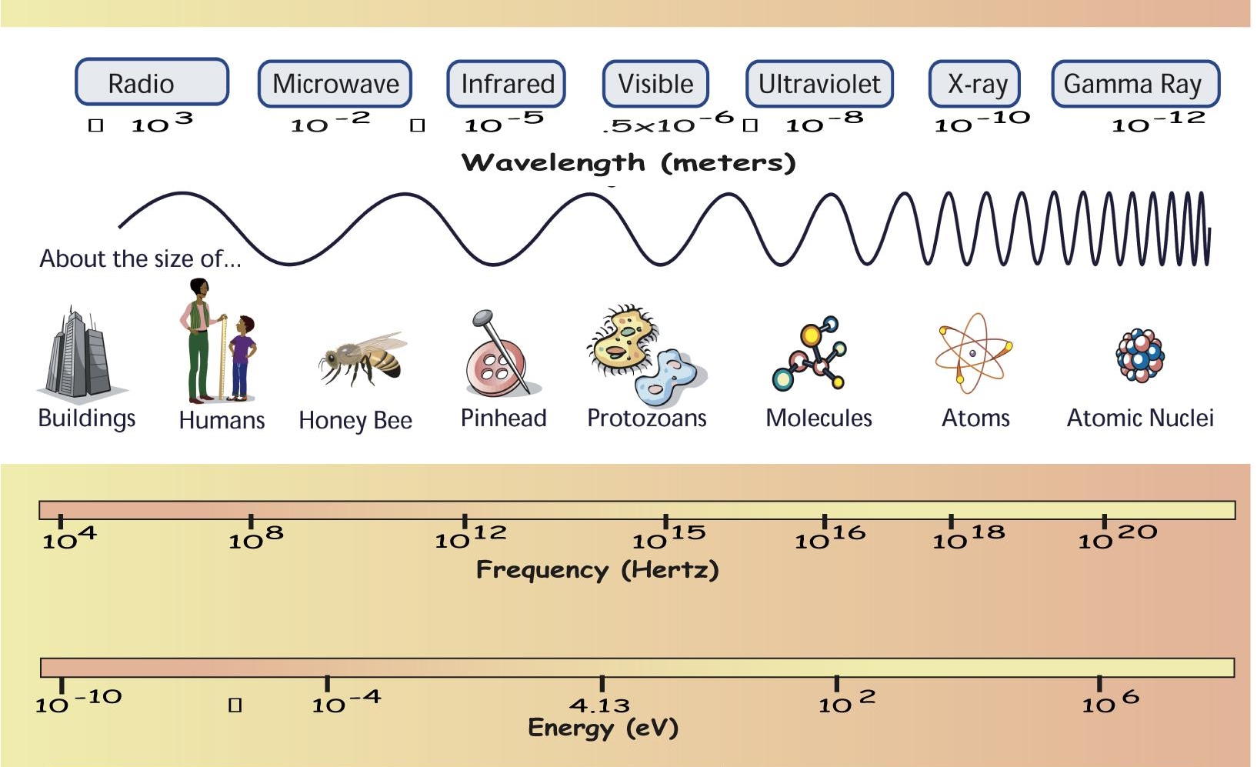
Gamma rays: E > 10⁶ eV

Slide 3
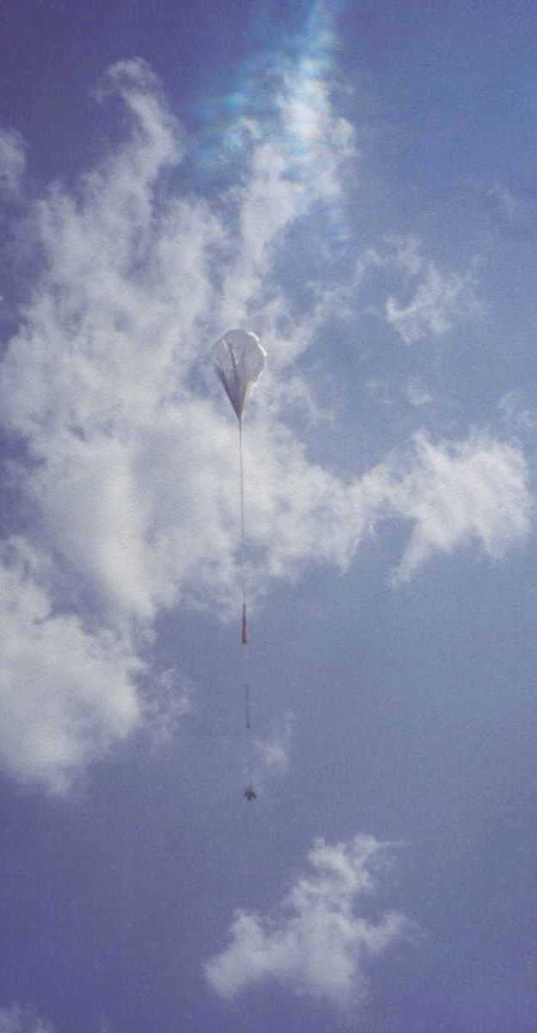
How to study Gamma rays?
Absorbed by the Earth’s atmosphere
Use rockets, balloons or satellites
Can’t focus gamma rays
Special detectors: NaI or CsI crystals, silicon-strips, CdZnTe
Balloon experiment

Slide 4
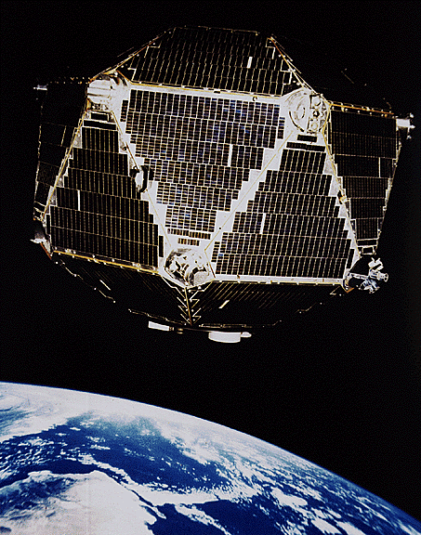
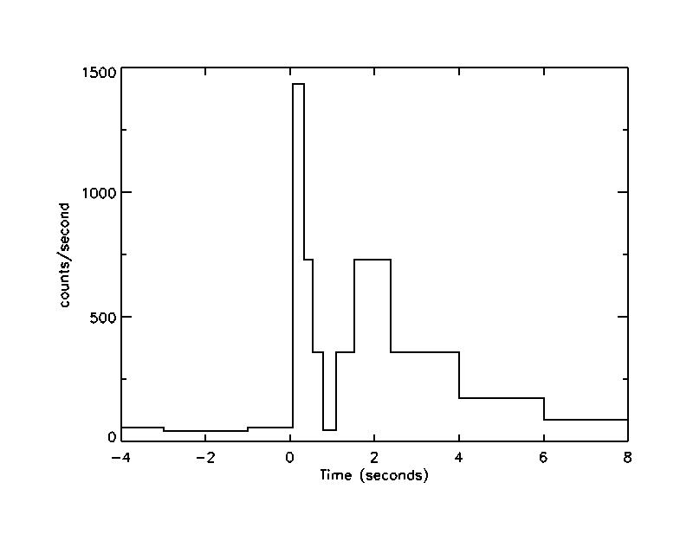
Vela Program (1969-1979)
FIRST GAMMA-RAY BURST
Discovered in 1971 while looking for nuclear test ban violations

Slide 5
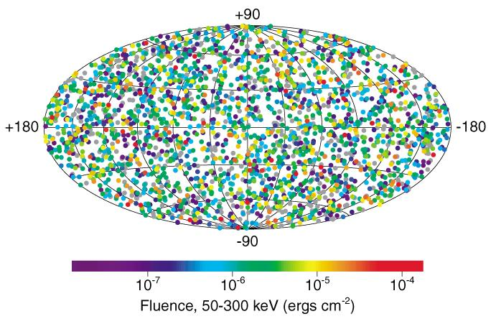
BATSE Gamma-ray Burst Sky
CGRO/BATSE
9 years of GRBs – no repeats in location
Birth cries of black holes?

Slide 6
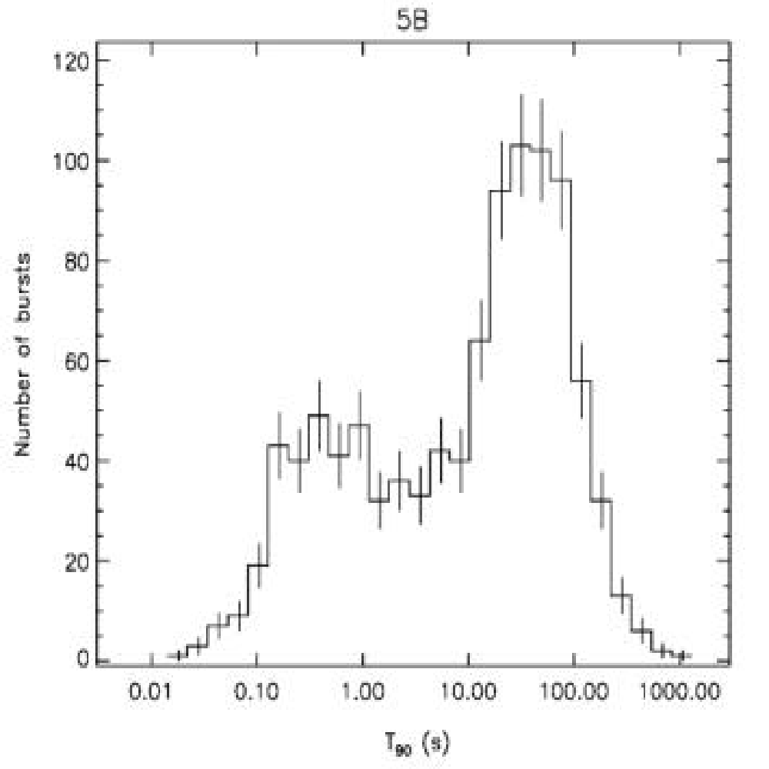
BATSE GRB Distribution
Shortest burst is 6 ms
Longest is 2000 s
Two classes
Divide at ~2 seconds
Shorter bursts are “harder”
Only long bursts have “afterglows”
0.5 s
35 s
Briggs et al. 2002

Slide 7
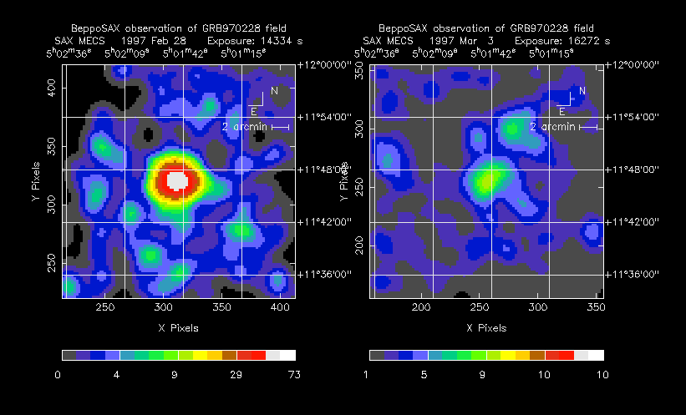
X-ray Afterglows
8.5 hours after GRB
5 days later
Discovered in 1997 by BeppoSAX satellite

Slide 8
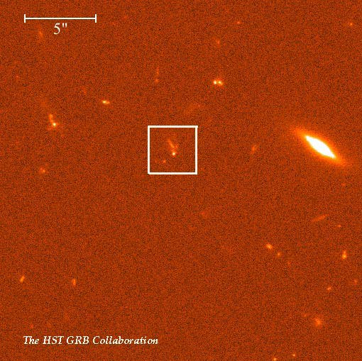
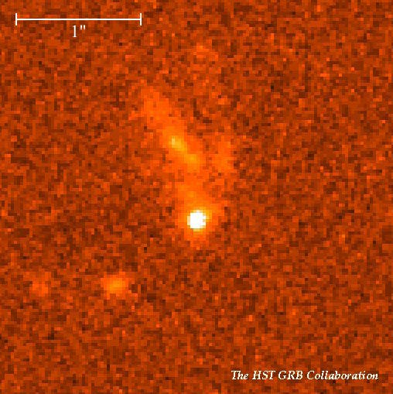
Visible Light Afterglows
Fading visible light persists for months
Redshifts from host galaxies 🡪 distances
Record: z = 4.5 🡪 12 billion light years

Slide 9
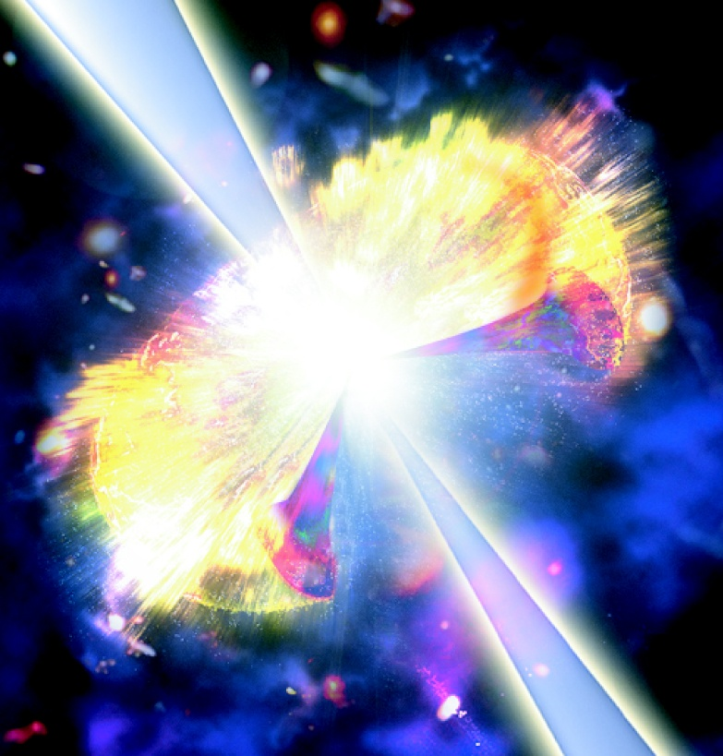
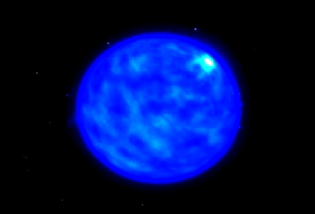
Hypernova
Credit: Dana Berry
Credit: D. Armbrecht
Super-supernova – death of star ~ 100 M_{o}
Material remaining after burst 🡪 afterglow

Slide 10
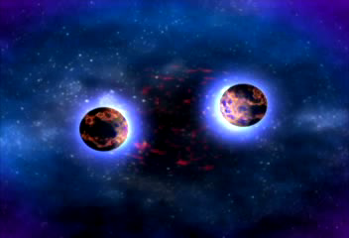
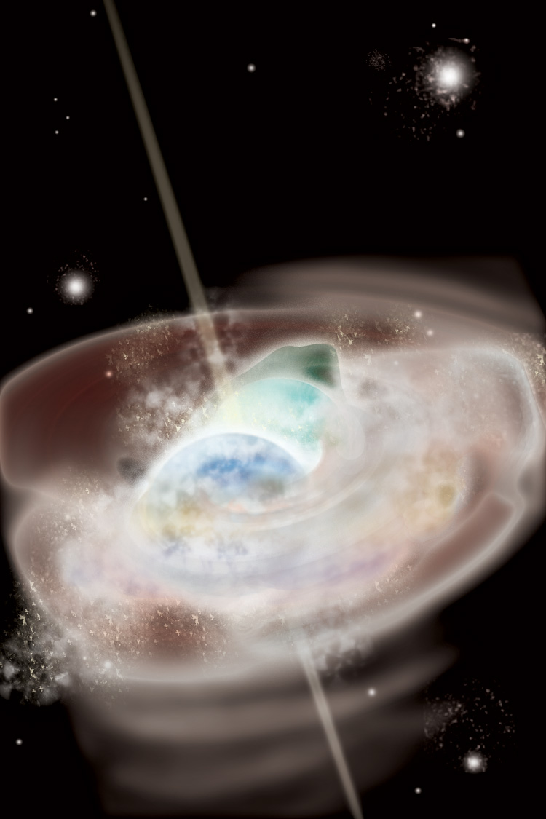
Catastrophic Mergers
Credit: Dana Berry
Credit: Aurore Simonnet
Death spiral of 2 neutron stars or black holes
Possible origin of short bursts

Slide 11
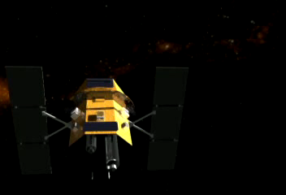


Swift Gamma-ray Burst Mission
Studies Gamma-Ray Bursts with a swift response
Survey of “hard” X-ray sky
Nominal 2-year lifetime

Slide 12
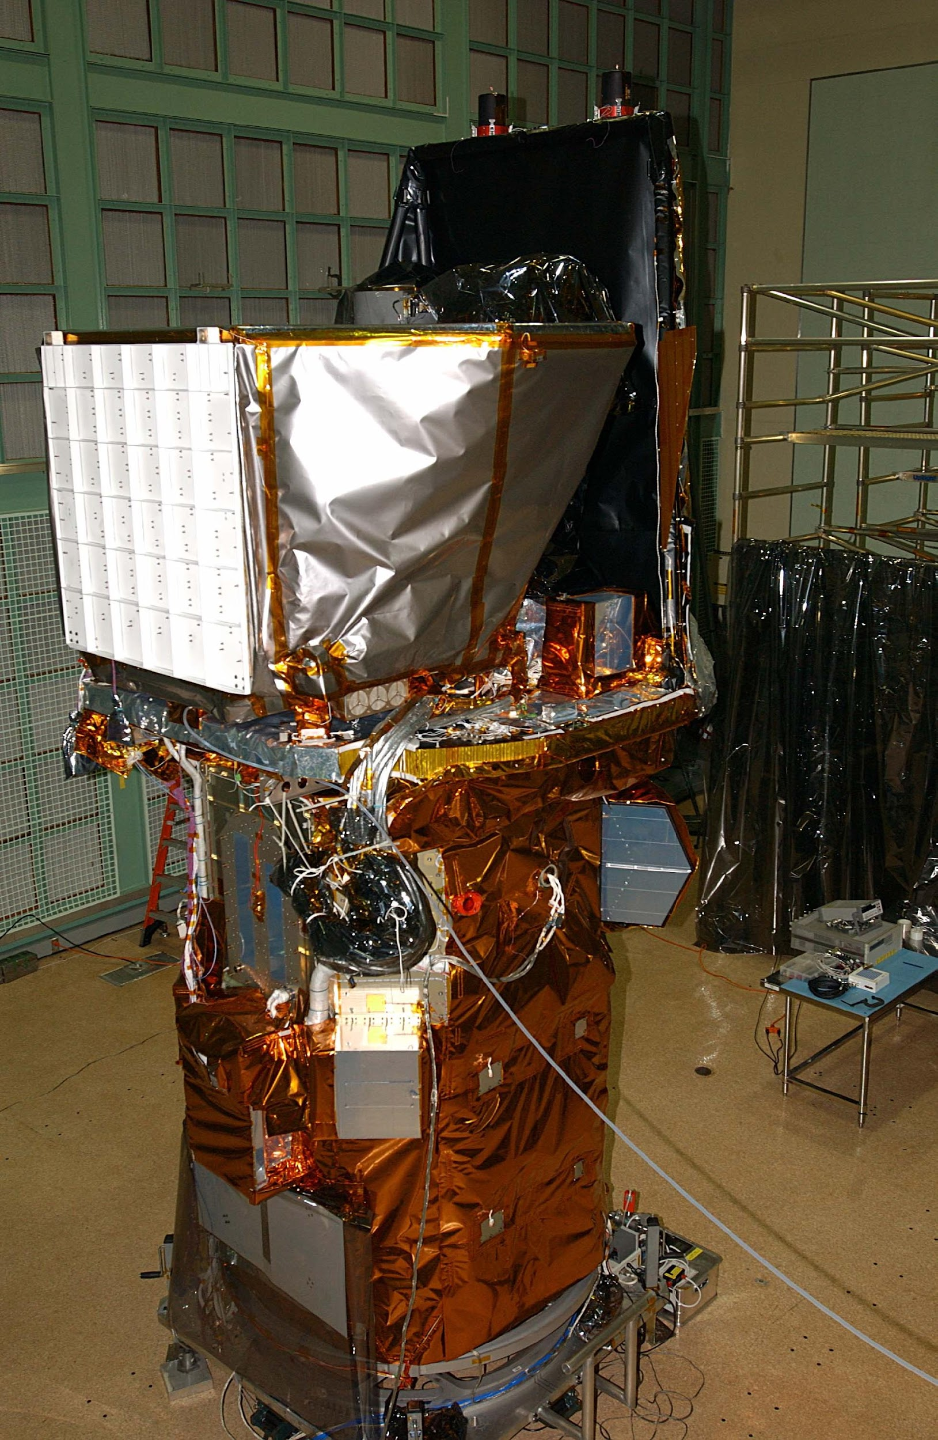
Swift Instruments
Burst Alert Telescope (BAT)
Ultraviolet/Optical Telescope (UVOT)
X-ray Telescope (XRT)
Autonomous re-pointing, 20 - 70 sec
Onboard and ground triggers
Swift in GSFC clean room

Slide 13
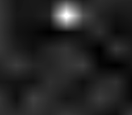
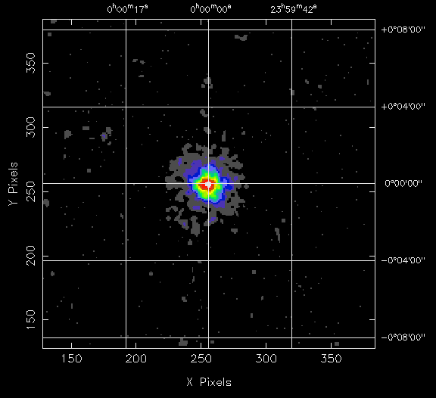
Observing Strategy
BAT triggers on GRB, calculates position to < 4 arcmin
Spacecraft autonomously slews to GRB position in 20-70 s
XRT determines position to < 5 arcseconds
UVOT images field, transmits finding chart to ground
BAT Burst Image
XRT Image
UVOT Image
BAT Error
Circle
T<10 sec
θ < 4'
T<100 sec
θ < 5''
T<300 sec

Slide 14
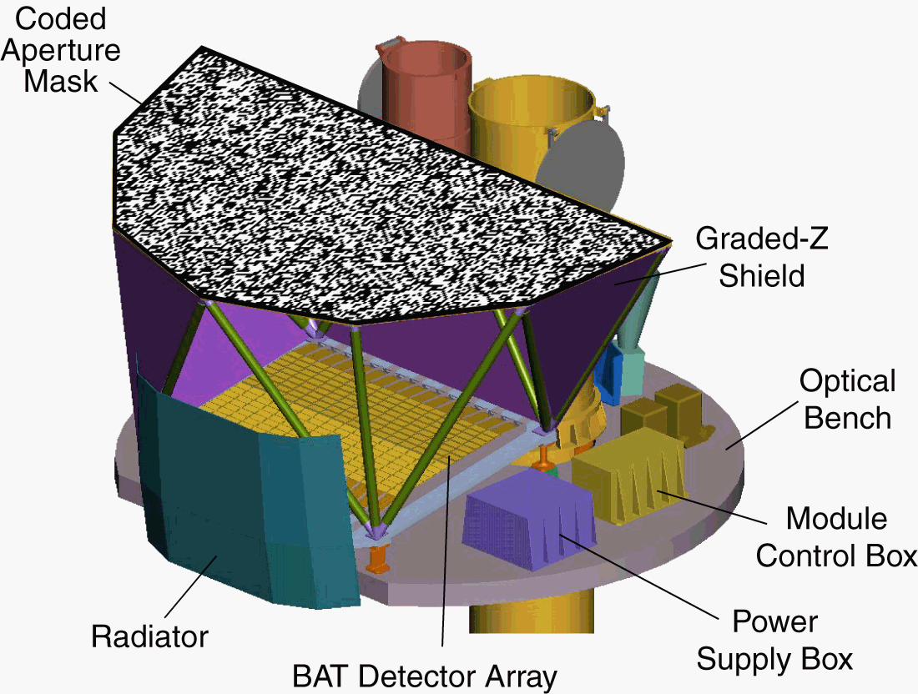
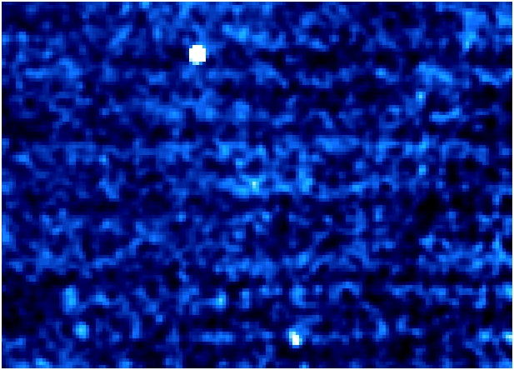
Burst Alert Telescope
Cyg X-1
Cyg X-3
Detect >100 GRBs per year
Most sensitive gamma-ray imager ever
CdZnTe detectors
First light image 1/5/05

Slide 15
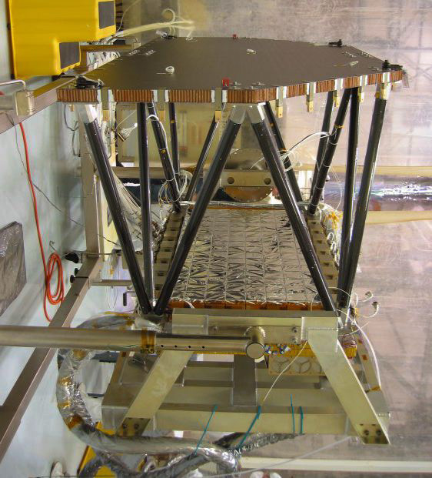
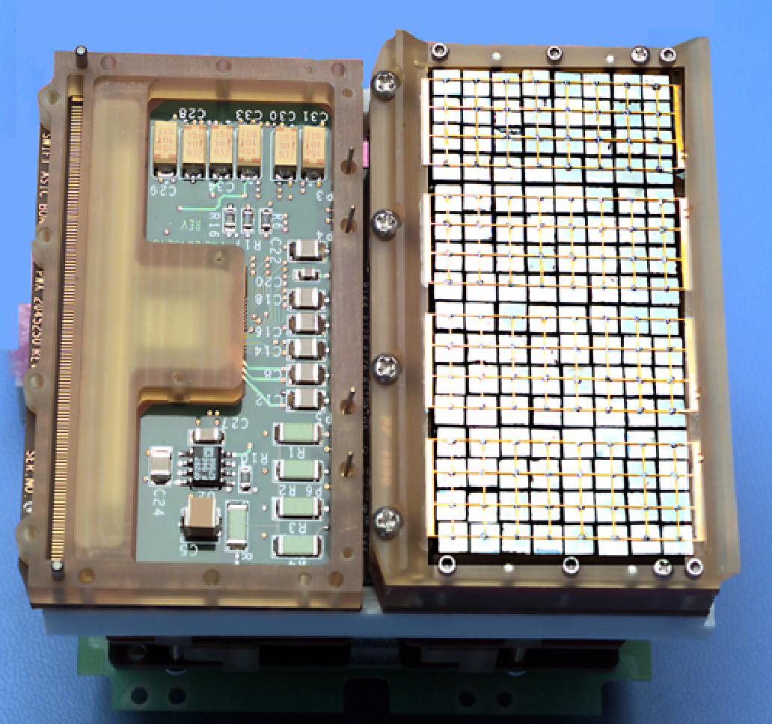
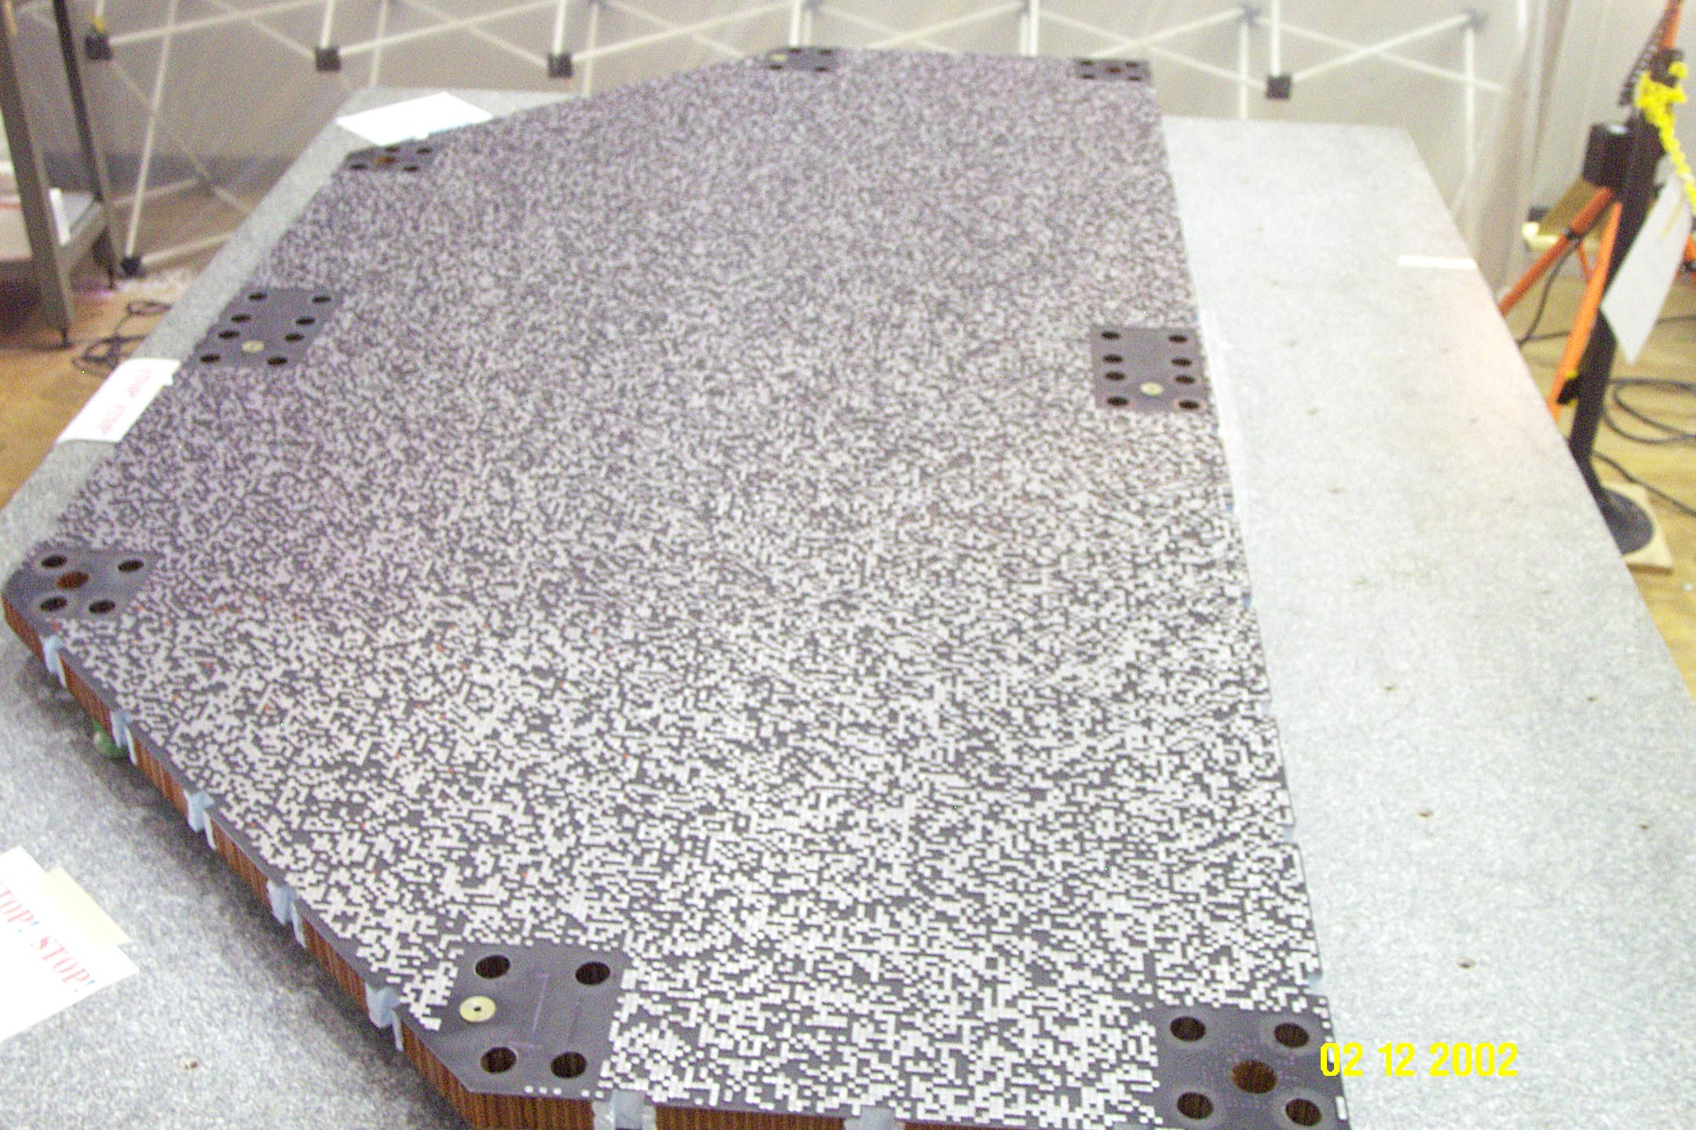
BAT Hardware
CdZnTe detectors
BAT Structure
Coded aperture mask

Slide 16
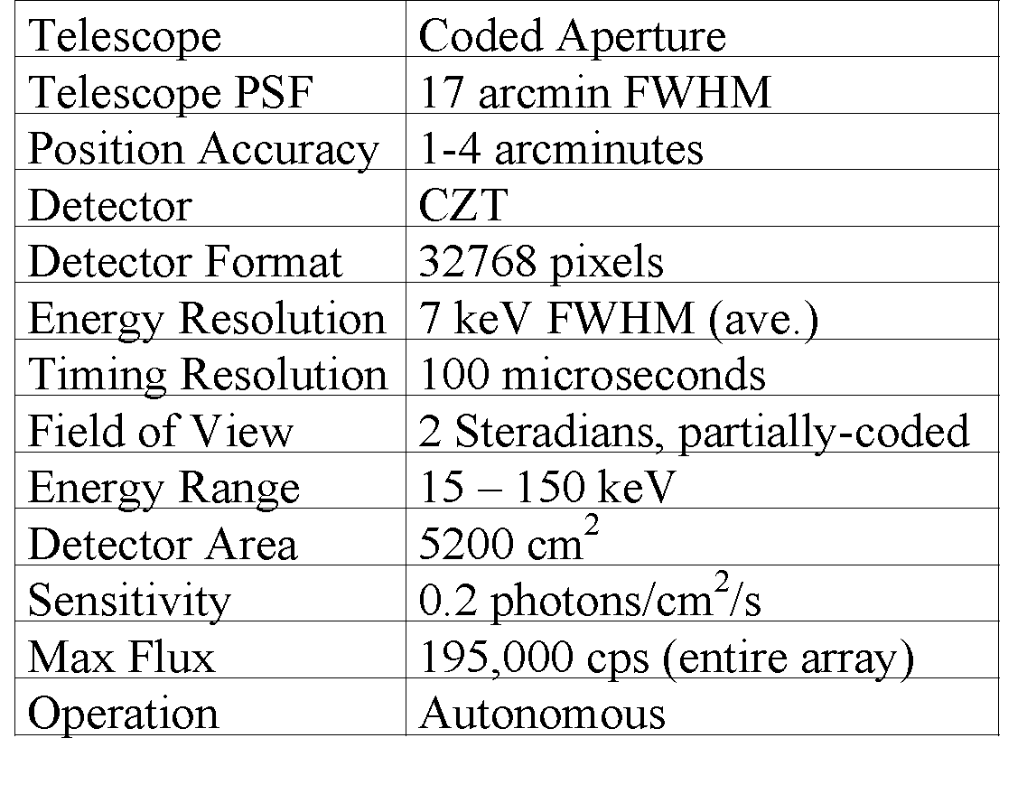
BAT Specs
BAT Characteristics

Slide 17
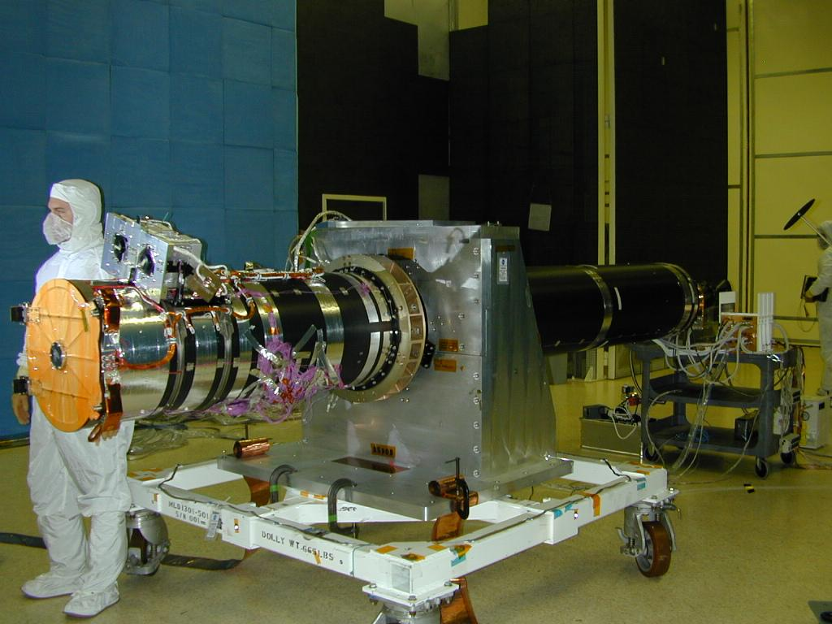
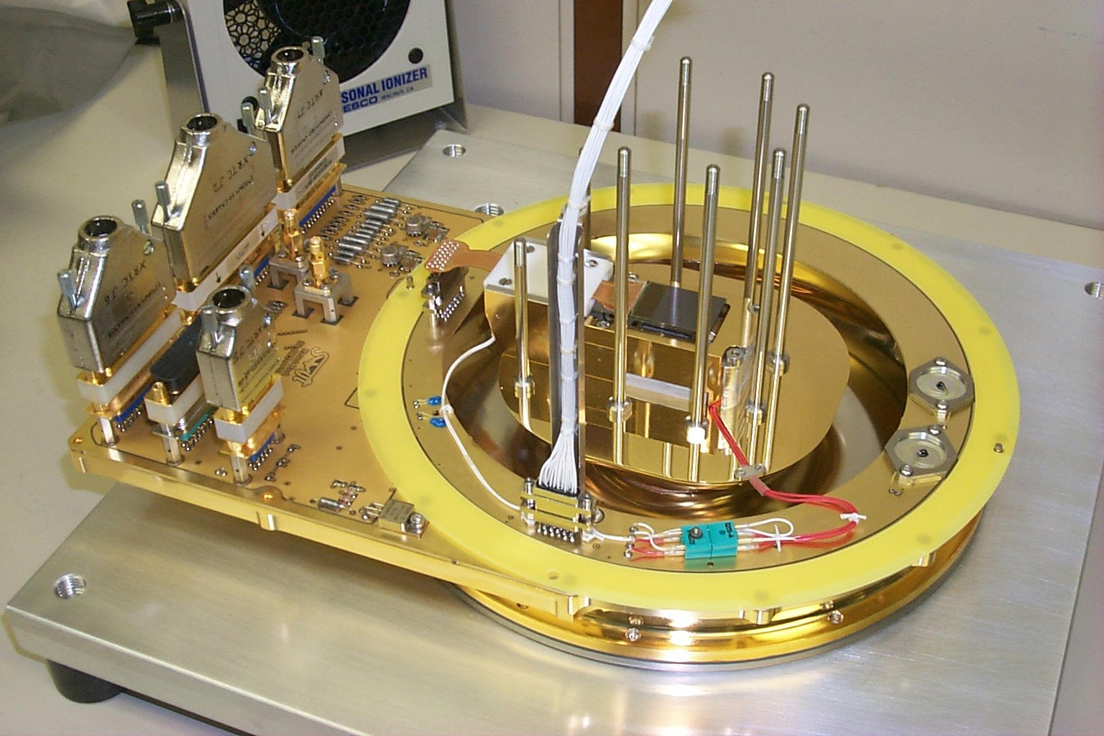
X-Ray Telescope
Arcsecond positions
CCD spectroscopy
XRT in EMI test lab
Grazing incidence mirrors
CCDs

Slide 18
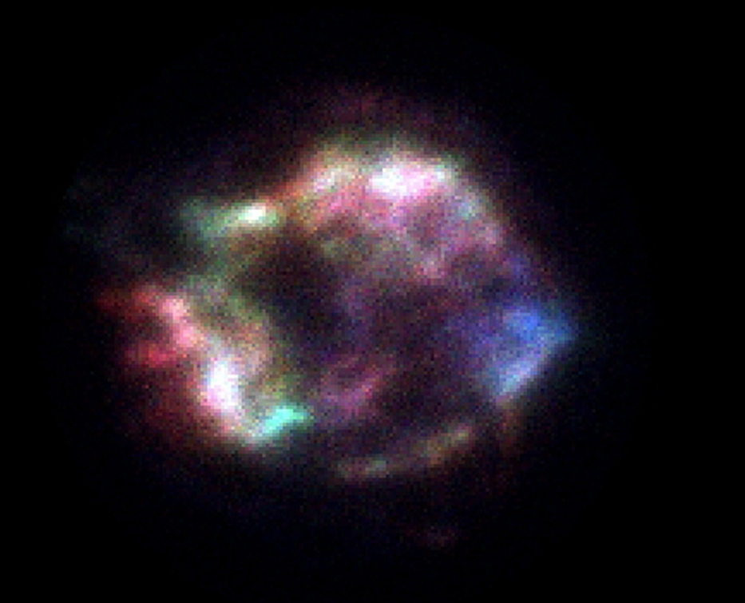
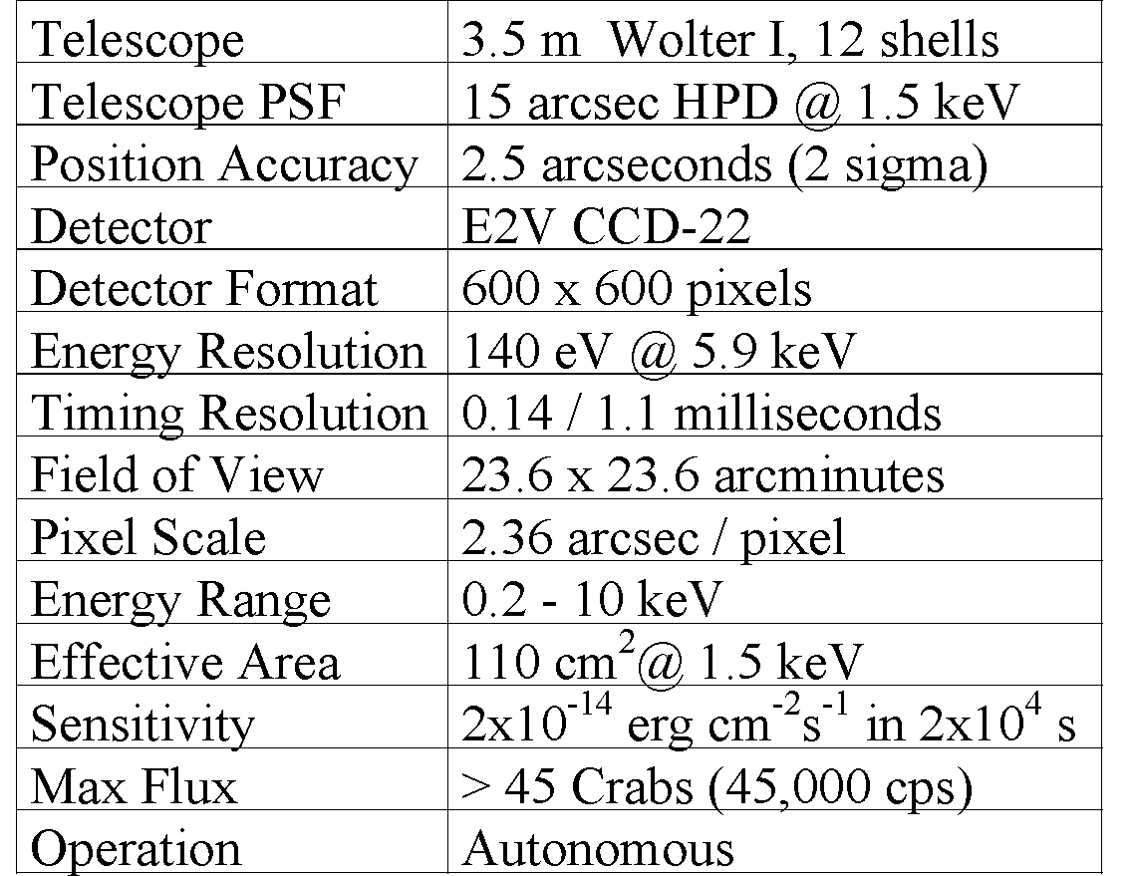
X-ray Telescope (XRT)
XRT Characteristics
•
Cas A
First light image 1/5/05

Slide 19
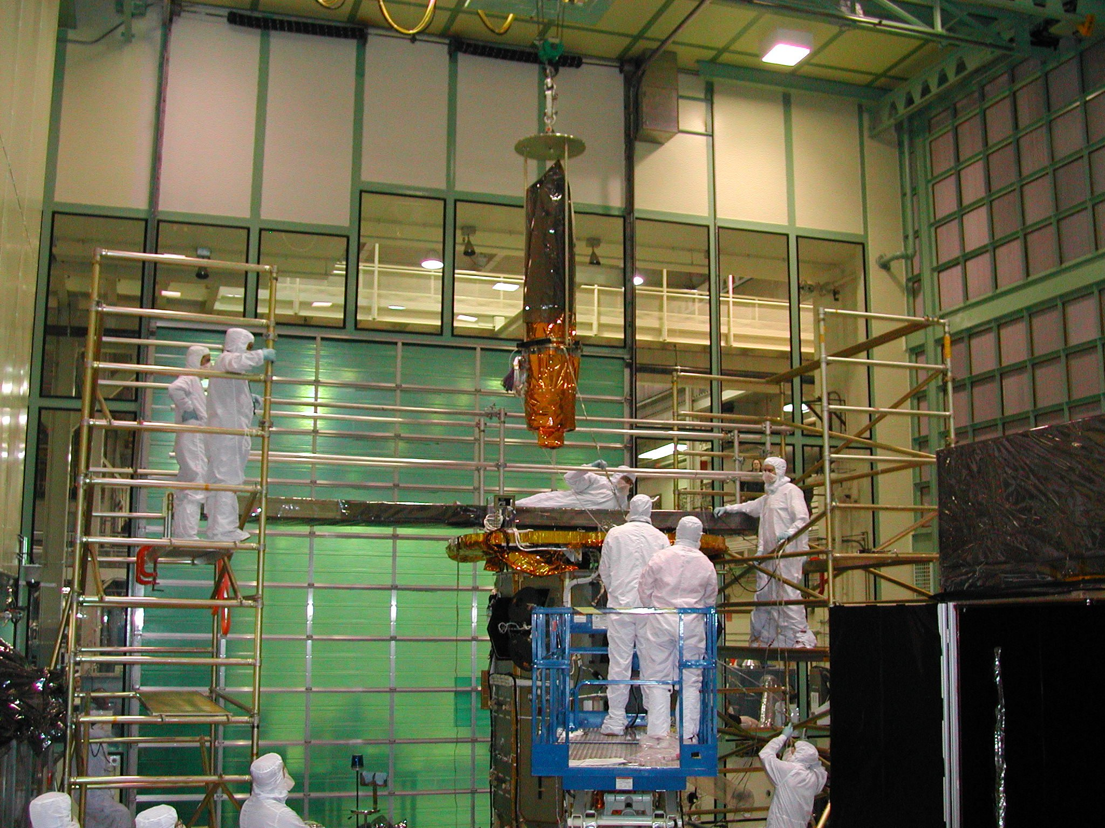
UV-Optical Telescope
Installation of UVOT
onto Swift S/C
5 ‘
Filter Wheel
Arcsec imaging
Grism spectroscopy
24th mag sensitivity (1000 sec)
Finding chart for other observers

Slide 20
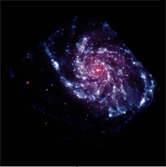
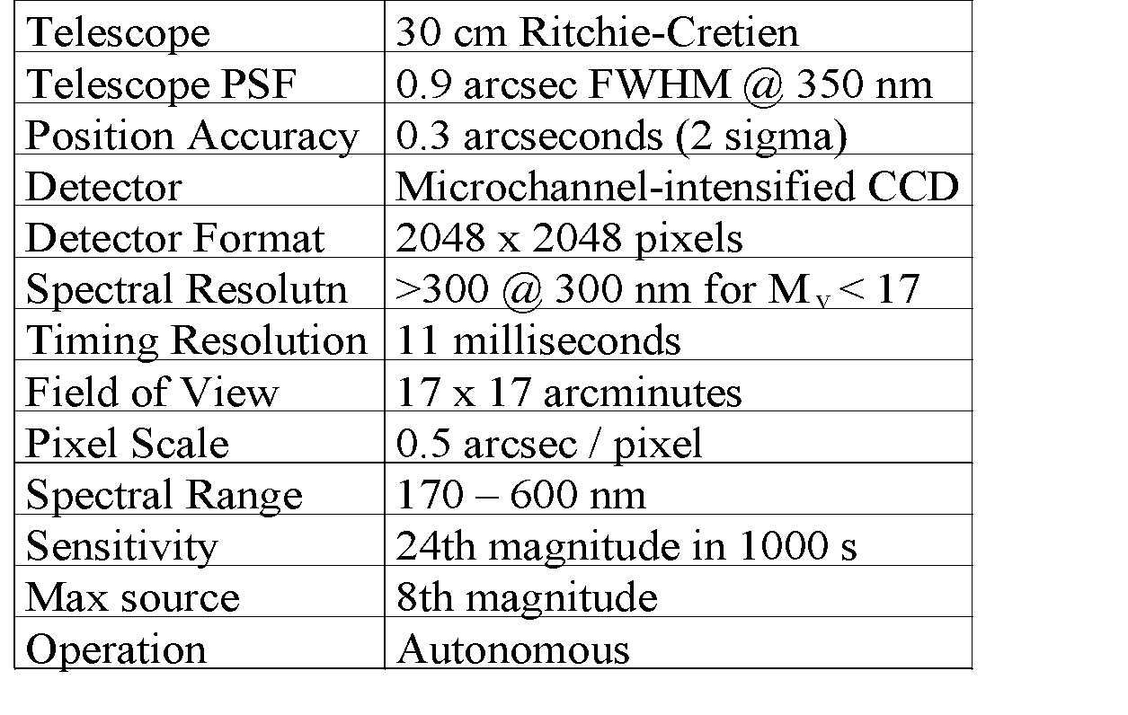
UVOT
UVOT Characteristics
M101
First light image 2/1/05

Slide 21
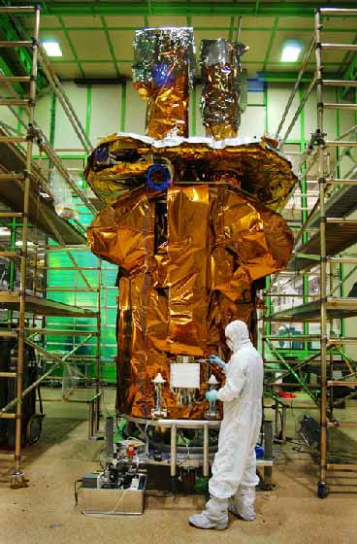
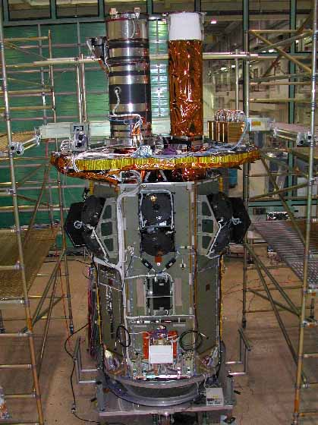
Spacecraft with XRT & UVOT Installed

Slide 22
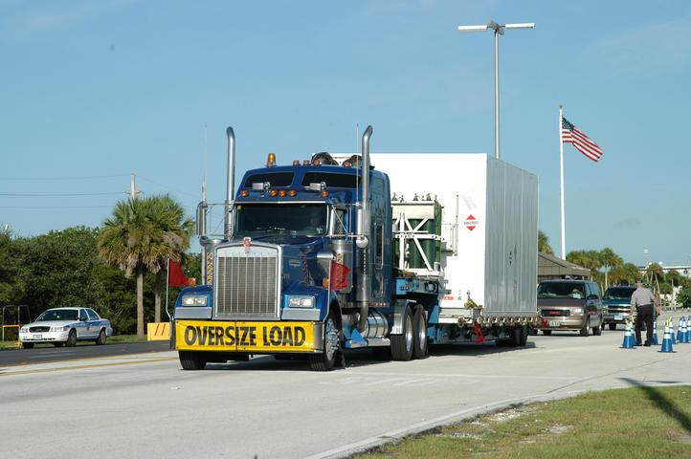
Swift arrives at KSC
7/29/04

Slide 23
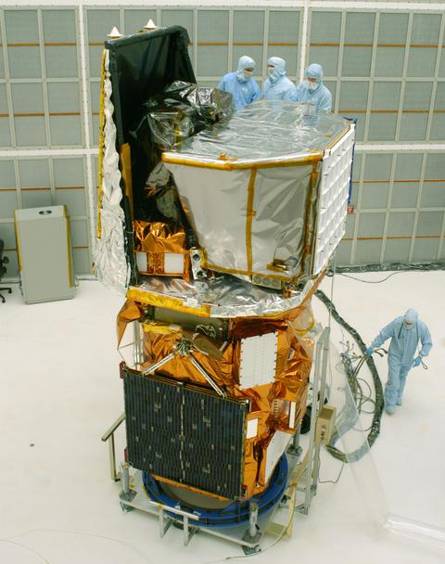
Swift at KSC
Sunshade shielding UVOT & XRT
BAT
Solar Panels

Slide 24
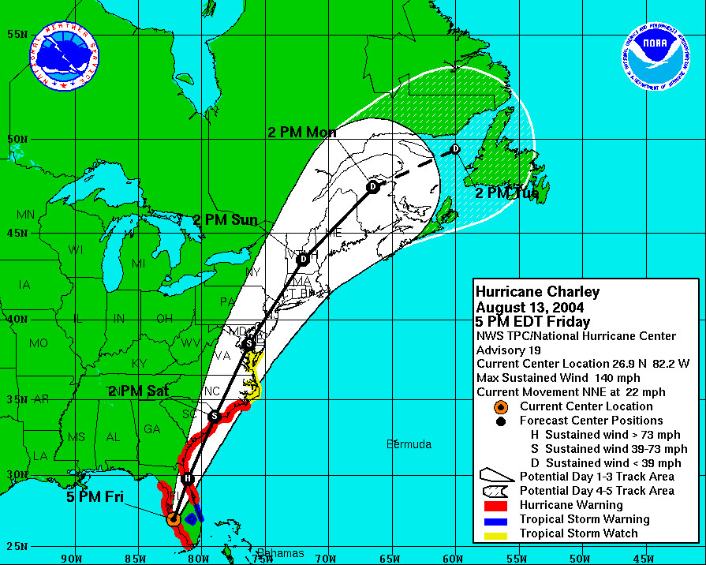
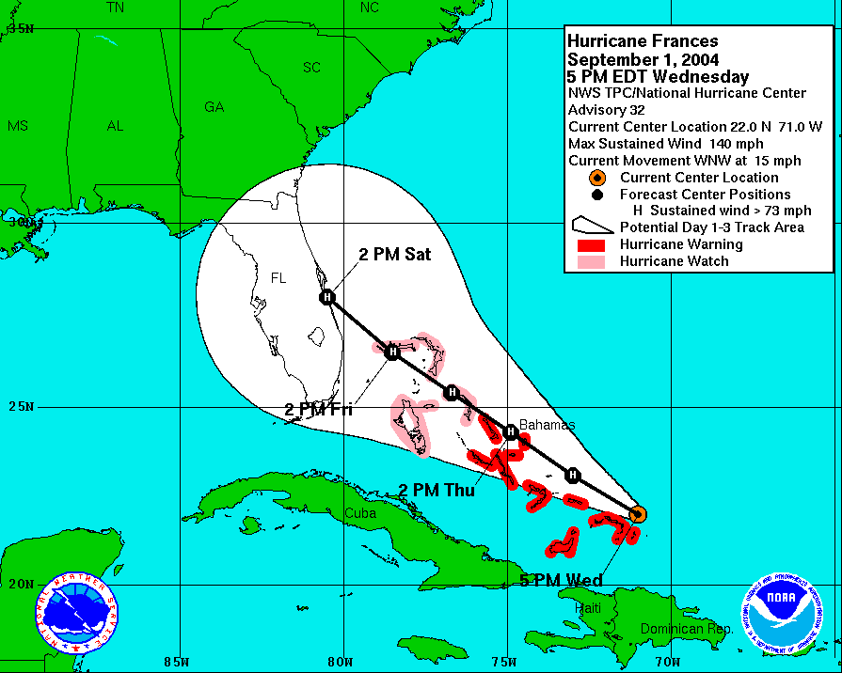
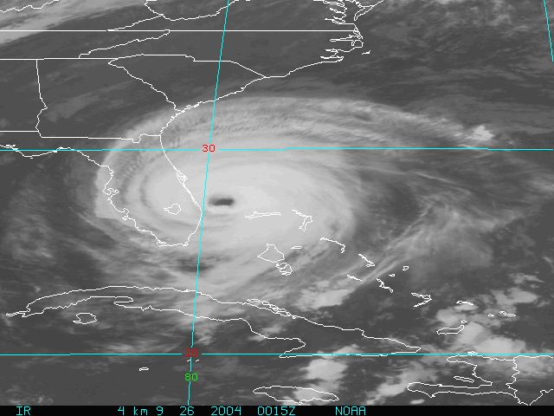
Florida becomes Hurricane Alley
Charley 8/13
Frances 9/4
Jeanne 9/25

Slide 25
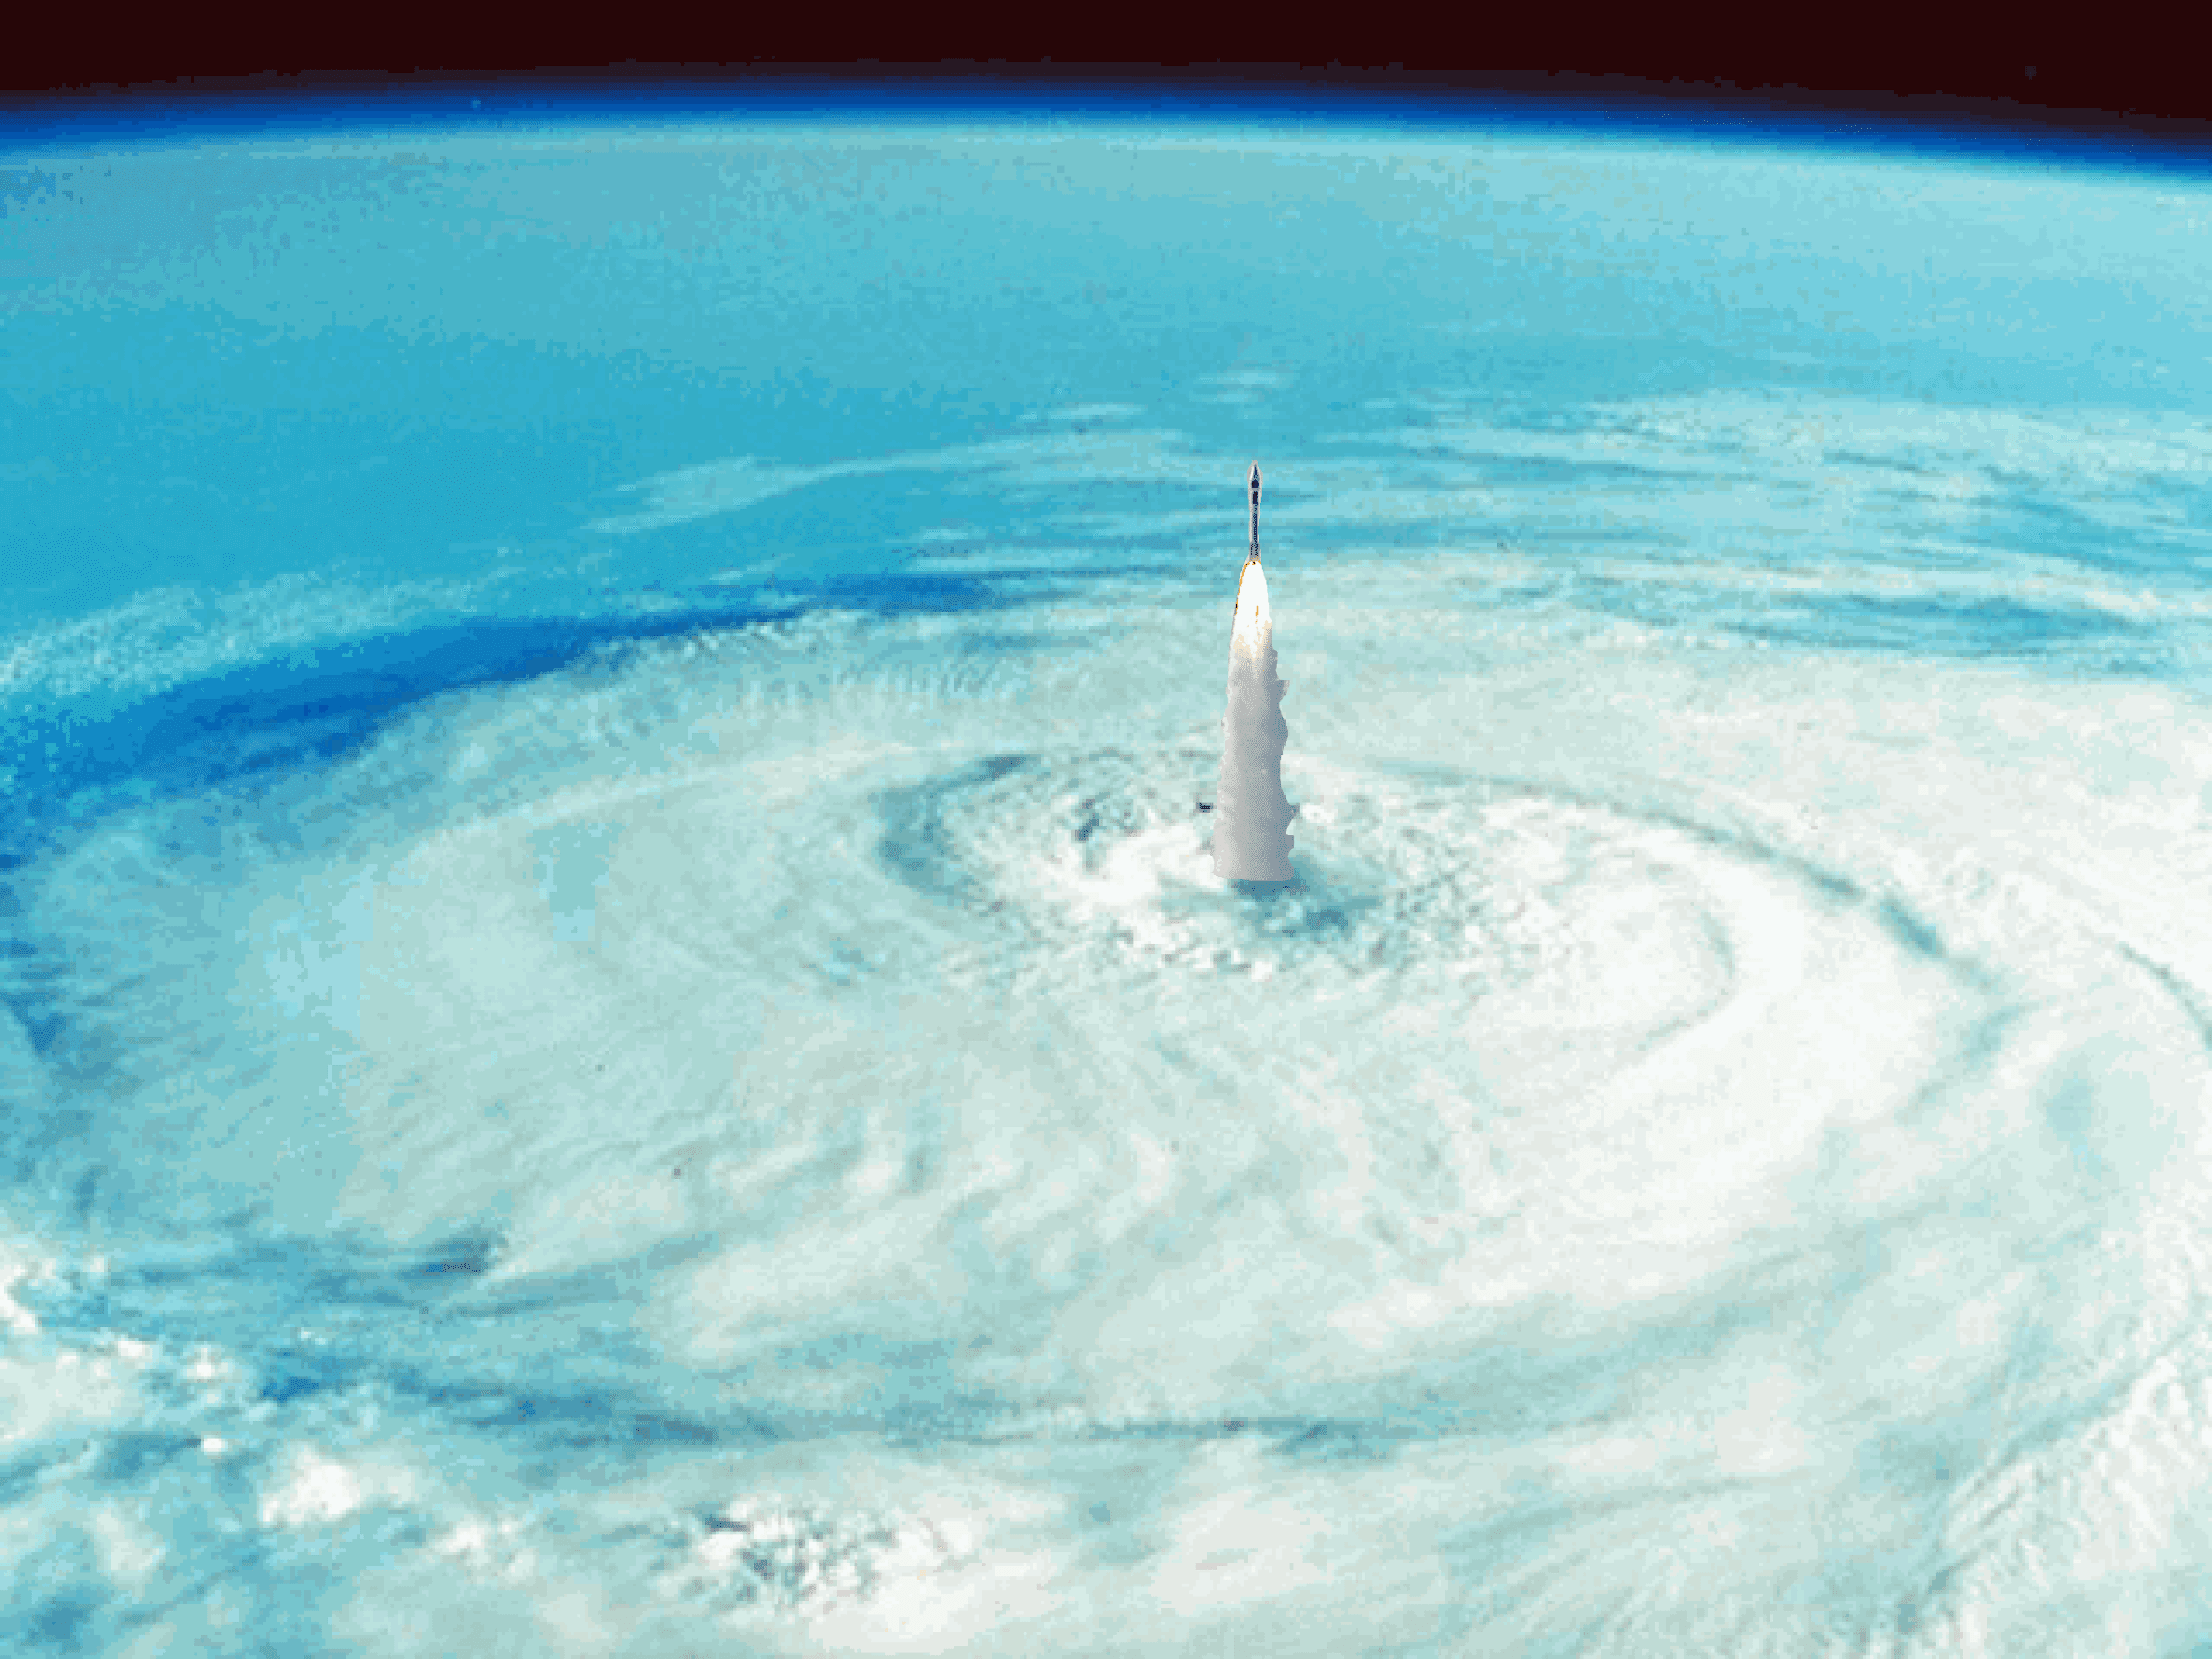
Let’s launch anyway!
It’s just a little bit of wind…

Slide 26
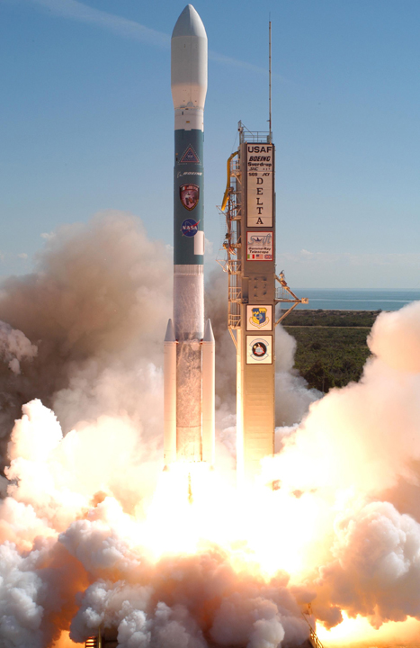
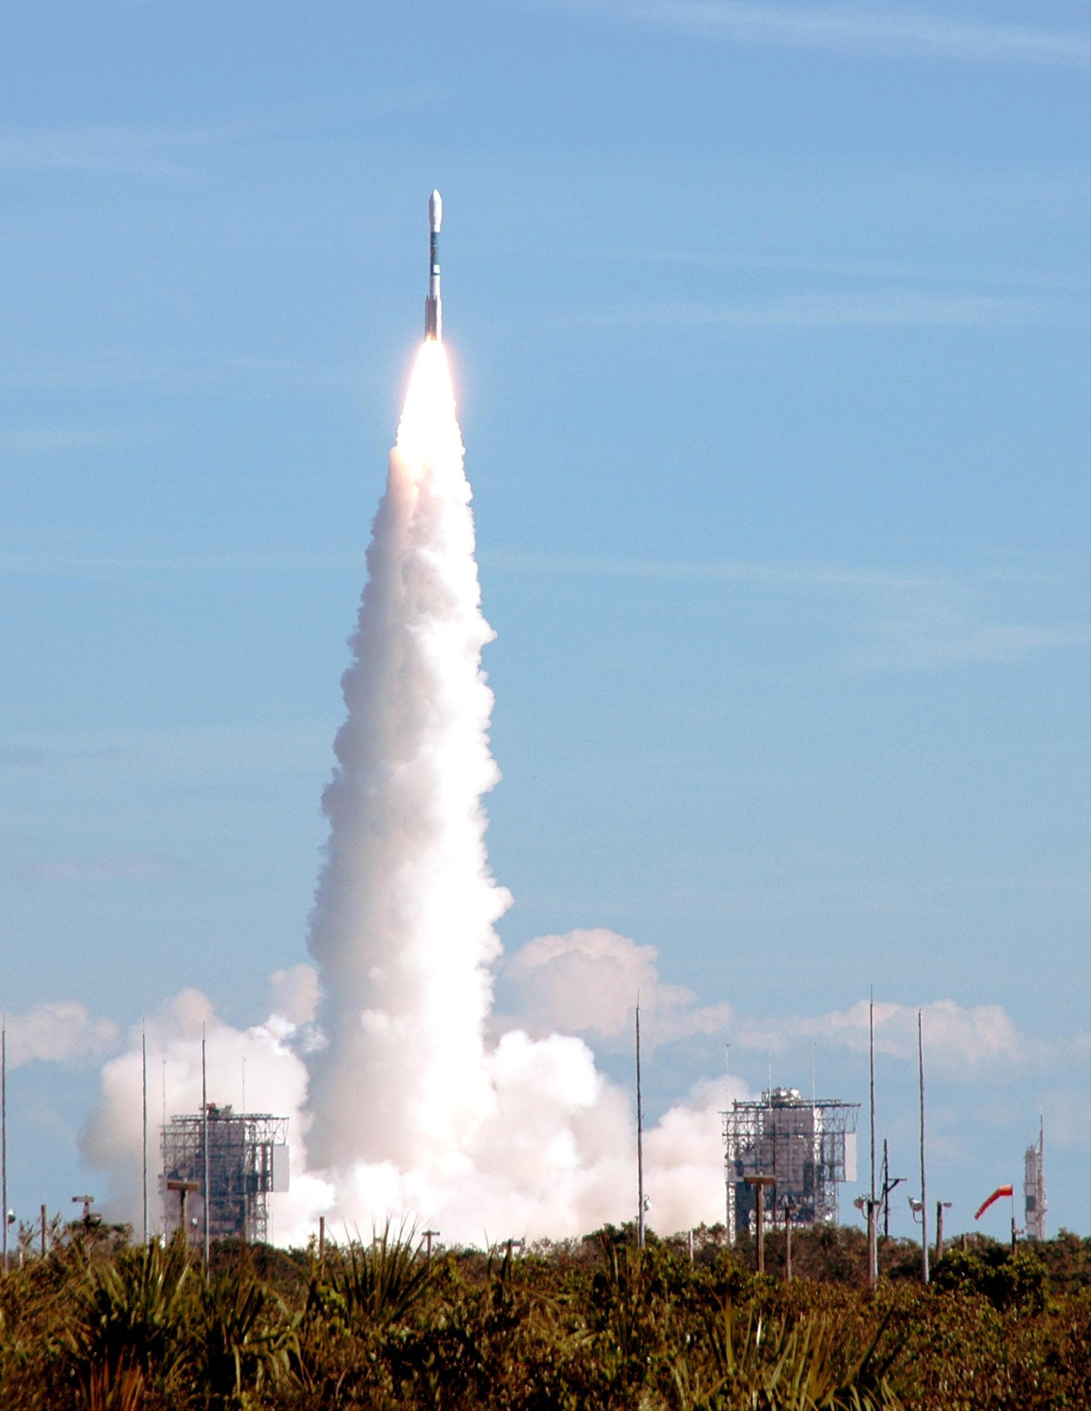
Swift launch 11/20/04
Fairing
3 Boosters

Slide 27

Swift launch movie

Slide 28
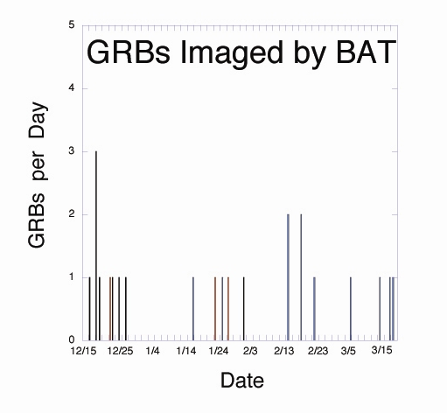
Swift burst history

Slide 29
Swift status in March 2005
All instruments activated
BAT detection rate is 92 ± 20 GRBs/yr (cf. 100 predicted)
Triggers include long GRBs, short GRB, XRF, SGR, XRBs
BAT background is 12 kHz (cf. 17 kHz predicted)
Autonomous slewing enabled and working
Of 23 GRBs imaged by BAT, 9 autonomous slews & 3 ToO slews
BAT GRB positions good to ~1 arcmin
XRT GRB positions good to ~2 arcsec
UVOT GRB positions good to <1 arcsec
Prompt GCN notices now enabled for BAT & XRT
Swift look direction soon to be a GCN notice
Observatory will be fully operational by Apr. 5, as promised

Slide 30
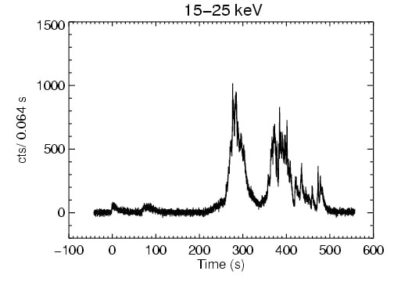
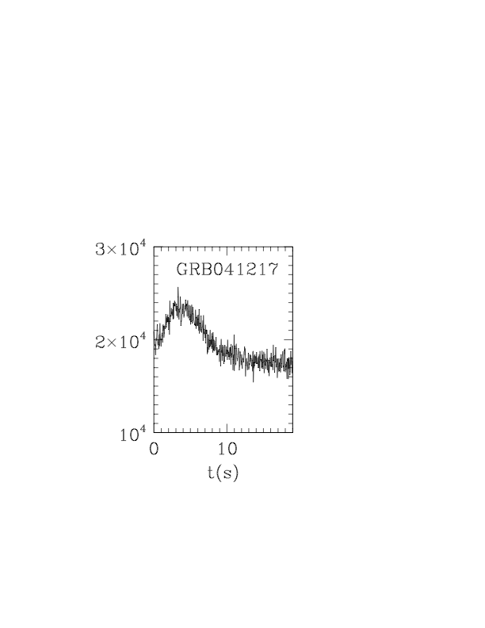
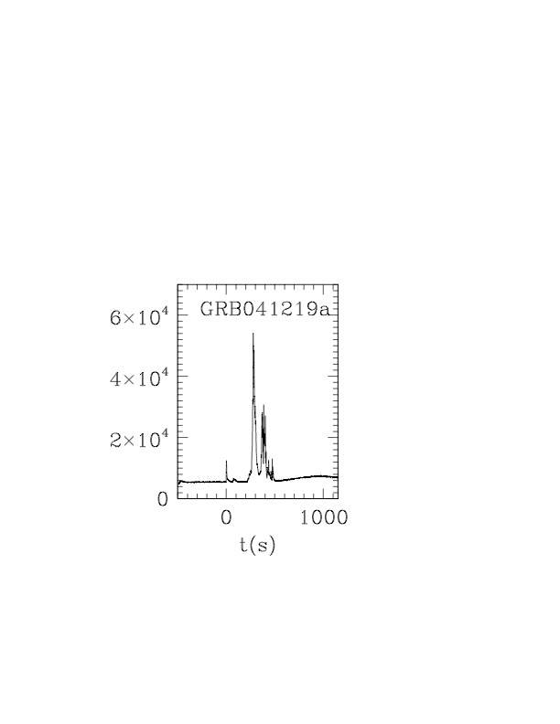
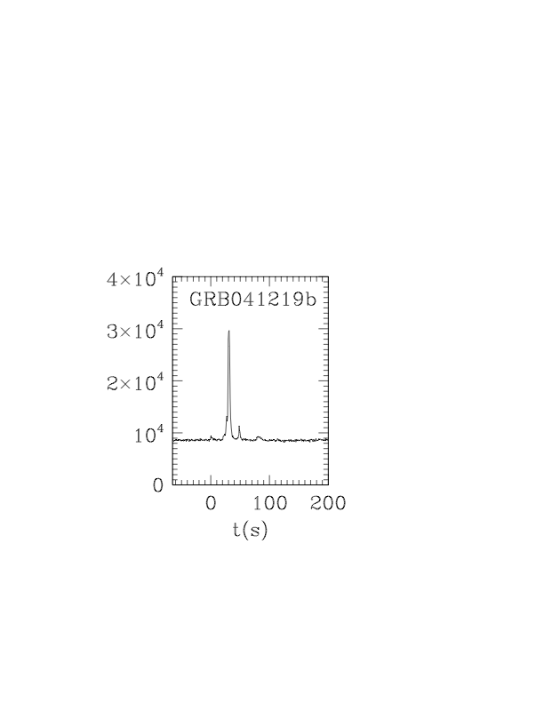
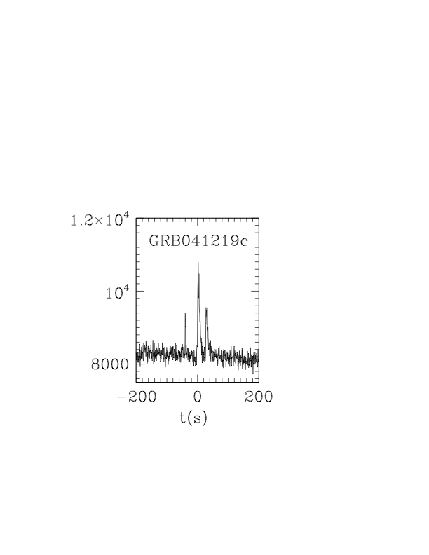
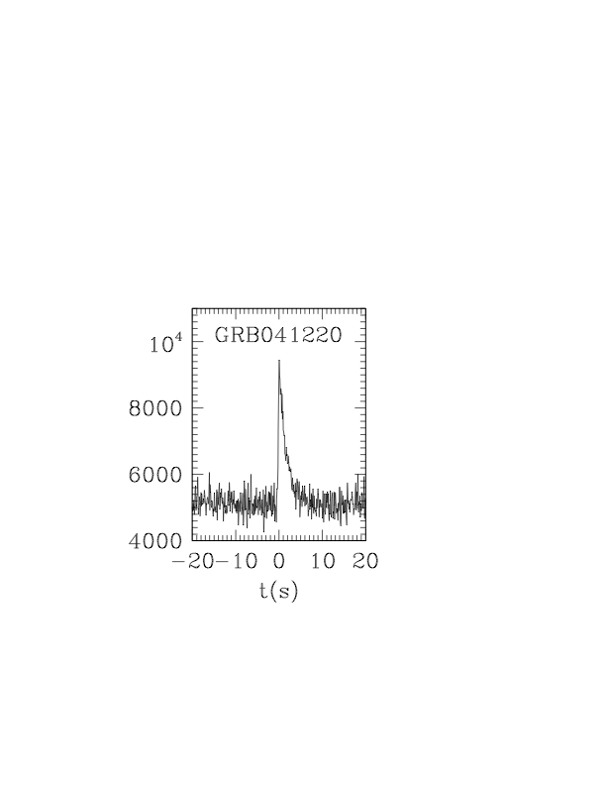
First 5 Swift bursts
GRB041219
fluence in top 1% of all bursts
duration in top 2% of all bursts
Optical and IR observations during prompt phase
*

Slide 31
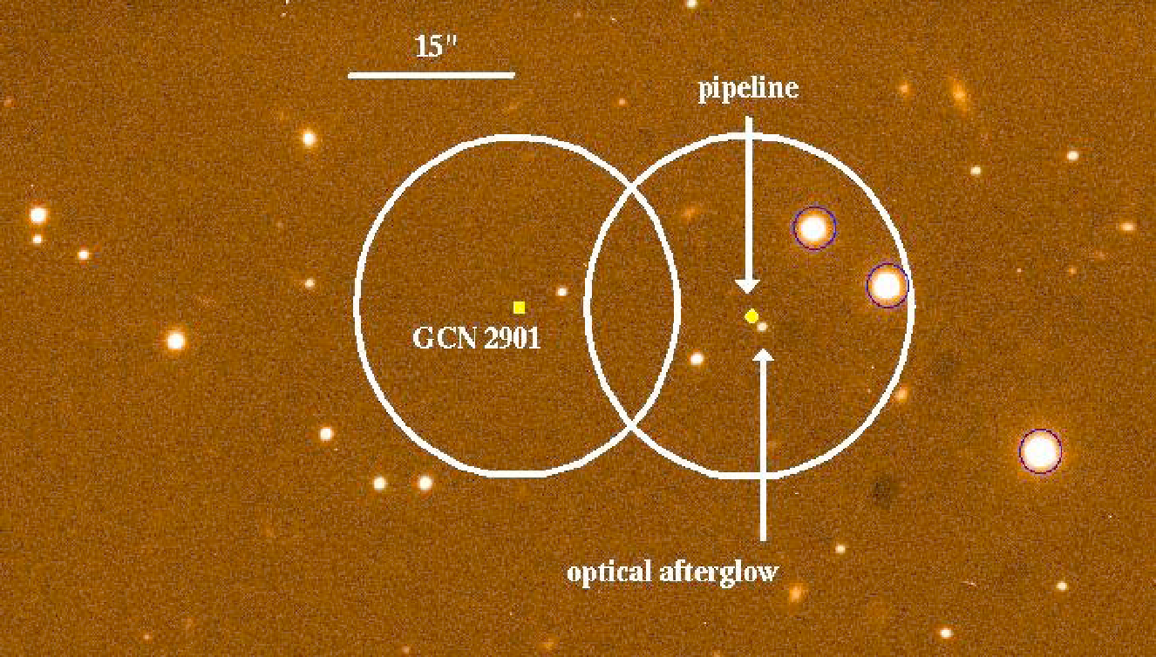
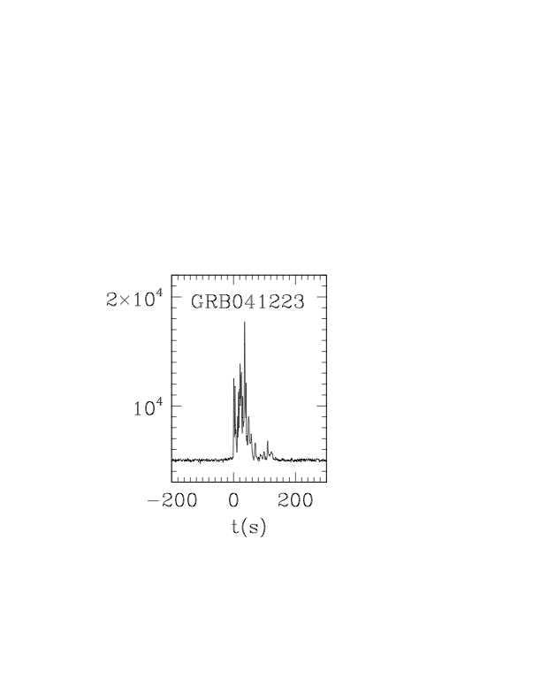
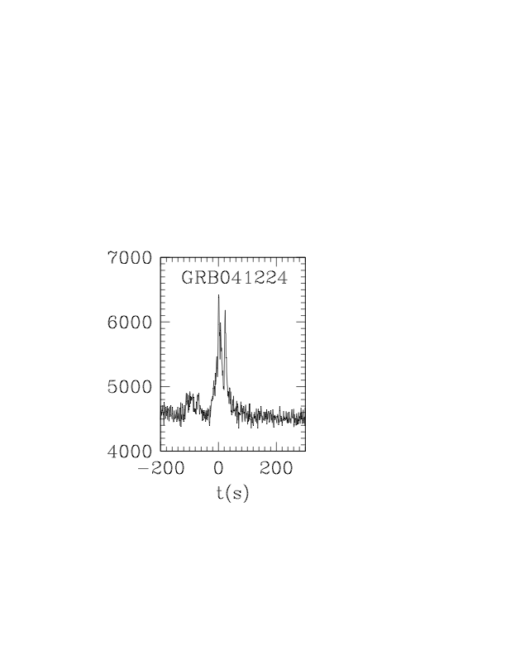




Next 6 Swift bursts
GRB041223 – first x-ray afterglow
*

Slide 32






Next 5 bursts
GRB050126 – first redshift z=1.29 (Keck)
GRB050202 – first short burst – but no slew
*
*
*
XRF050215b
Observed by Swift & HETE
• Epeak < 30 keV
• Very weak x-ray afterglow

Slide 33





Most recent 7 bursts
GRB050315 – redshift 1.949 (Magellan)
*
GRB050318A –RXTE and Swift –Magellan redshift 1.44 – first UVOT afterglow detection!
GRB050319A –Japanese 14 inch telescope detects afterglow! - ROTSE detects 16th mag object 27 s after burst

Slide 34

Follow Up Network
44 members using telescopes that span the globe

Slide 35

Fly the Gamma-ray Skies
Follow GRBs, SGRs, etc. on the Gamma-ray Coordinates Network or the GRB Skymap site
Join the Global Telescope Network and monitor GRBs and Blazars over the Internet (later talk)

Slide 36

For more information:
http://swift.sonoma.edu
http://grb.sonoma.edu
http://gtn.sonoma.edu
http://gcn.gsfc.nasa.gov
http://imagine.gsfc.nasa.gov
http://www.metroactive.com/papers/sonoma/01.12.05/blackholes-0502.html -or Google Cominsky Bohemian
Credit: Rory McNamara

